Slide 1

Master Of Science in Computer Engineering and AIDE
Distributed Systems and Middleweare Technologies
DS_Auction
Megan Maremmani
Eleni Zewdu Belayhun
Ettore Di Donato

Slide 2
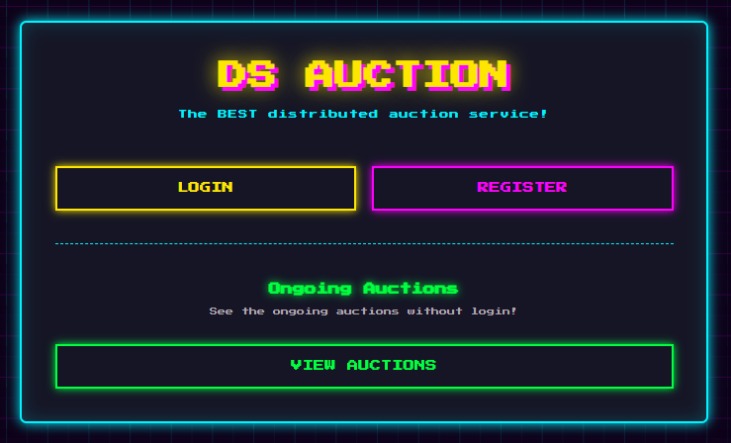
THE IDEA
A Distributed web application where Users can sell their retro/vintage games and consoles creating their own online auctions
Mockup of the homepage
Notes:
megan

Slide 3


FUNCTIONAL REQUIREMENTS
Some of the main requirements of the application:
Unregistered User
Registered User
System
Allow Unregistered users to browse the application
Unregister users can register and create an account
Unregistered users can view ongoing auctions and history.
Unregistered users can view the chat without the ability to interact.
Registered users can browse the application
Registered users can login
Registered users can view ongoing auctions, their bid history and bid in them.
Registered users can write in the chat and see the chat history
Registered users can sell items and see the winner of the auctions
Manage registered users and organize auction items.
Manage the timing issues and bids
Sync ongoing auctions and remaining time in real-time.
Automatically select a unique winner at the end of an auction
Review submitted items to ensure data completeness.
Notes:
megan

Slide 4

NON FUNCTIONAL REQUIREMENTS
The main non requirements of the application are:
The System must be always available
The System must be fast responsive
The system must handle auction bids correctly following the imposed rules.
The system must announce the winner correctly
Given the requirements we started thinking about the possibile issues of the application
Notes:
Eli

Slide 5
SYNCHRONIZATION AND COMMUNICATION ISSUES
Race Conditions: Serialize simultaneous bid requests to ensure a consistent state.
Timing Issue: Coordinate timers so all users view the same remaining time.
Timer Reset Logic: Synchronize the specific 30-second timer reset across all clients.
Bid Visibility: Broadcast valid bids and history to all participants in real-time.
State Propagation: Update all users on ongoing bids and new system-accepted auctions.
Sequential Bidding: Enforce constraints to prevent consecutive bids by the same user.
Winner Determination: Correctly identify and announce the winner across all nodes.
Chat Ordering: handle concurrent messages and prevent context loss.
Notes:
eli

Slide 6
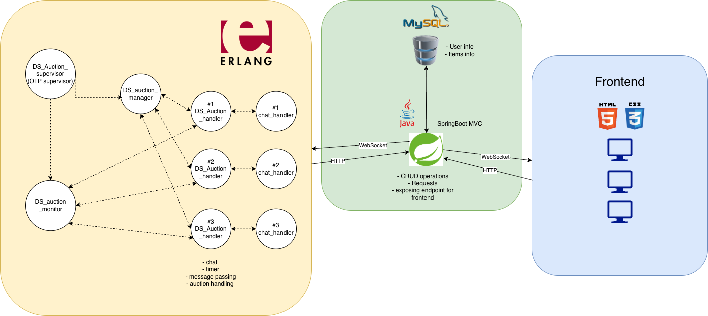
GENERAL ARCHITECTURE
Image of the general architecture
Notes:
ettore

Slide 7
SERVER SIDE - ERLANG
The main actors for the ErlangServer are:
DS_Auction_supervisor: spawns the monitor and the manager and supervises them, OTP supervisor behaviour.
DS_Auction_monitor: monitors each individual auctions and chat and communicates with java
DS_Auction_manager: spawns the auction handler and the chat
DS_Auction_handler: manages the bid logic and winner handling, as well as timing issues
chat_handler: handles the chat mechanism
Notes:
Eleni and Megan

Slide 8
CLIENT SIDE
DataBase
GUI
Containers
MySQL database was chosen to ensure proper handling of the information and to have ACID atomic operations
Made with HTML and CSS to have a personalized and ad hoc option for the application.
Oused as a mockup for the project GUI interface.
The web application is deployed on 4 containers:
Erlang Manager on container 10.2.1.48
Erlang worker is on 10.2.1.13.
Java/SpringBoot side is deployed on container 10.2.1.25
DB is deployed on container 10.2.1.47.
Notes:
megan

Slide 9

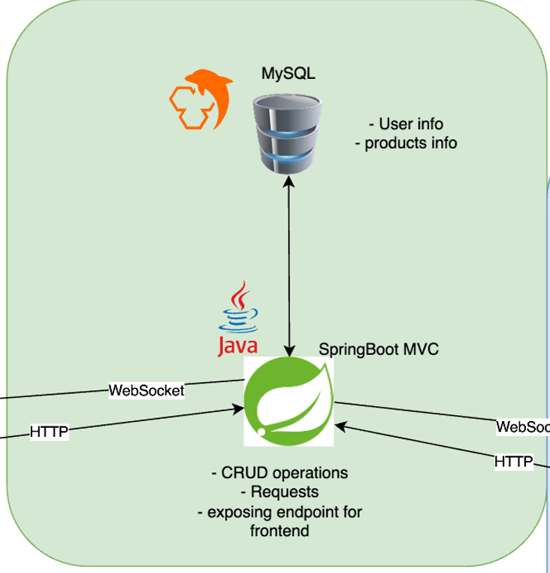
JAVA
Spring Boot MVC
Configs
Controller: Auction, item and users and their actions.
Model: models for items, users and auctions
Service: business logic for items, users, auctions and erlang
Repository: for items and users
SpringSecurity.java: Configures the security layer by defining authentication rules and controlling authorized access to specific URLs
WebSocketConfig: Enables real-time, two-way communication between the server and connected clients
Notes:
Ettore

Slide 10
COMMUNICATION
Interaction between erlang and java is achieved with the JInterface library, which allows the Java application to act as a native node within the Erlang distributed network.
Node Configuration
Message Passing
Clock
Java runs as java_node@10.2.1.25, and Erlang runs as auction_service@10.2.1.48, with a worker node on 10.2.1.13.
Authentication is done with a shared secret (cookie).
Java initializes a persistent OtpMbox named java_listener, used to receive asynchronous messages from Erlang.
Synchronous RPC-style calls and asynchronous message passing.
On bid submission, ErlangService creates a temporary mailbox, builds OtpErlangTuple and sends it to DS_auction_handler. Java waits for the response
For asynchronous events, Erlang sends messages to the java_listener mailbox
Prevents clock drift between clients and Erlang
Implements Cristian’s Algorithm for time synchronization.
Client requests server timestamp and measures Round Trip Time (RTT).
Calculates network delay and clock offset.
Notes:
Ettore

Slide 11
SOLUTION TO SYNCHRONIZATION AND COMMUNICATION ISSUES
The solution for these problems in concurrency and synchronization is handled by the Erlang language and the WebSockets.
The main logic is implemented in Erlang and Erlang processes possess a mailbox where incoming messages are queued and handled sequentially.
The Erlang handler decrements the remaining time internally and provides a synchronization API to align all the erlang processes' clocks with the server and streaming it to java
The Erlang Manager and Handlers give updates to the Java node, like bids, chat and winner, via JInterface
Then the Java service uses WebSockets to immediately broadcast these updates to clients
This architecture ensures that while clients may be distributed, they all visualize a view of the system that is consistent with the serialized logic executed by the Erlang server.
Notes:
eleni

Slide 12
USER MANUAL & MOCKUPS 1
Homepage Mockup
Notes:
Megan

Slide 13
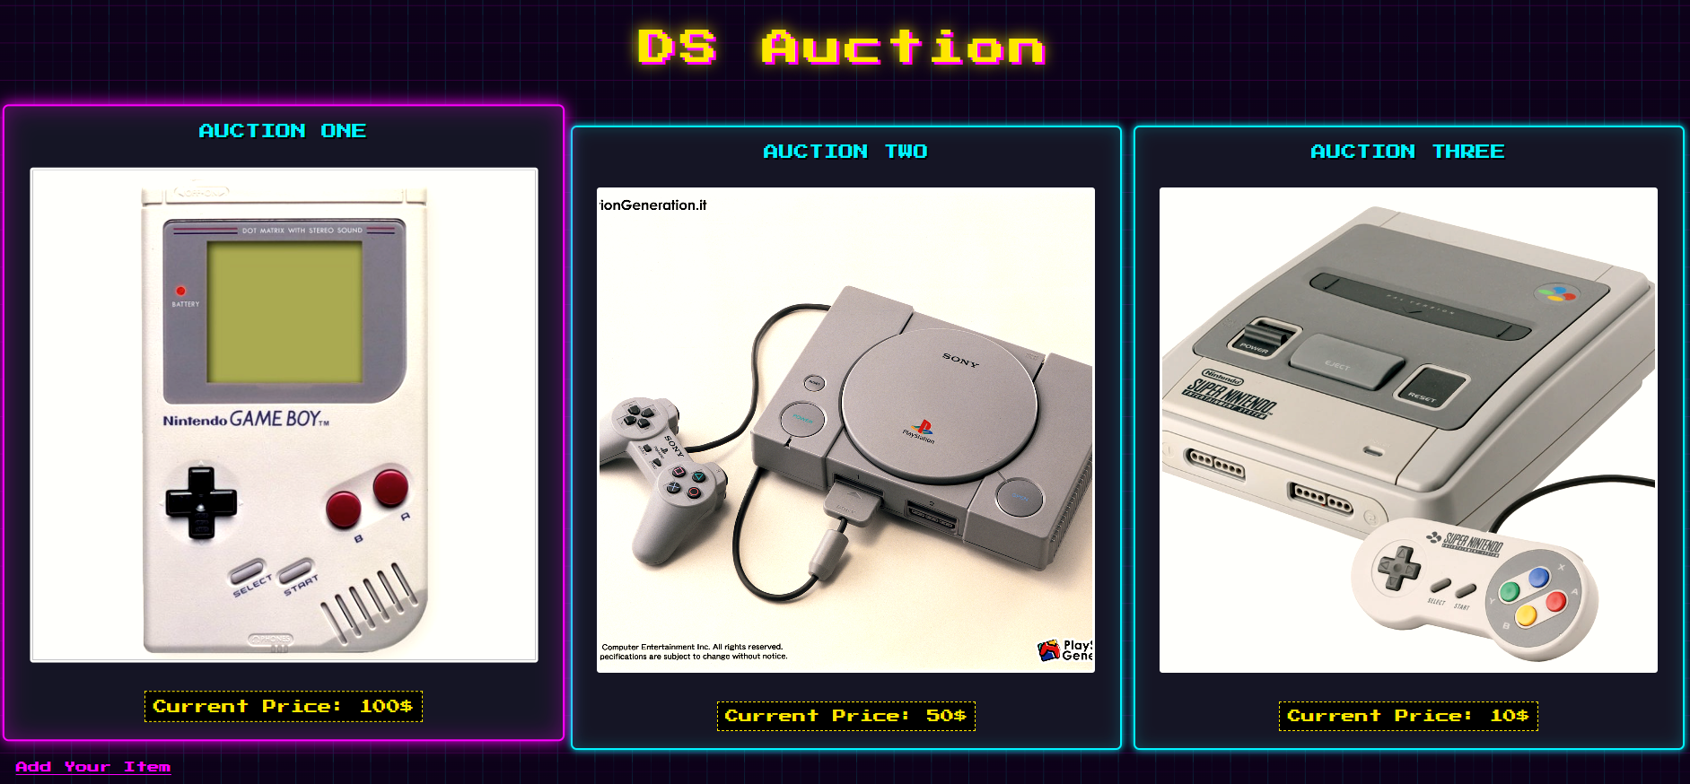
USER MANUAL & MOCKUPS 2
Auction list

Slide 14
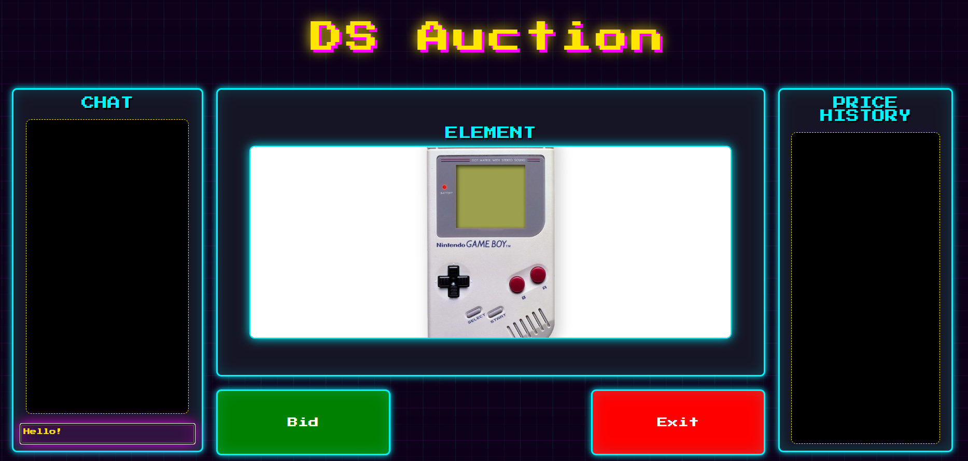
USER MANUAL & MOCKUPS 3
Ongoing auction

Slide 15
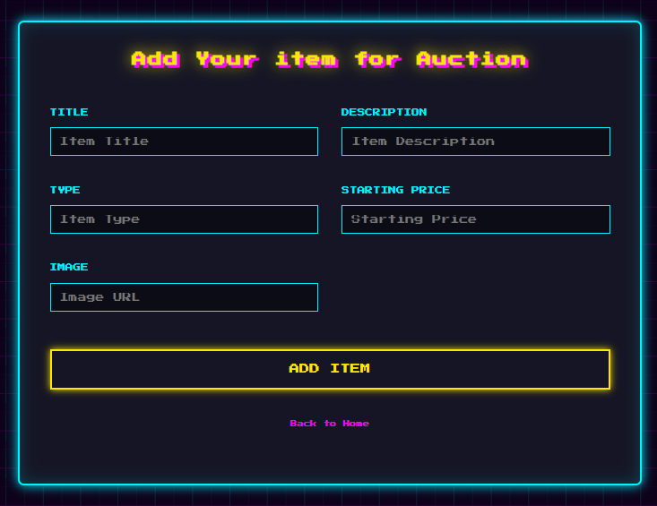
USER MANUAL & MOCKUPS 4
Adding item

Slide 16
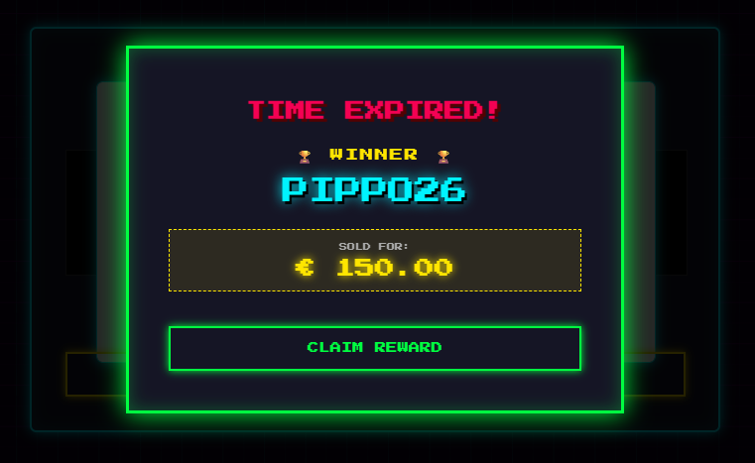
USER MANUAL & MOCKUPS 5
Winner handling

Slide 17
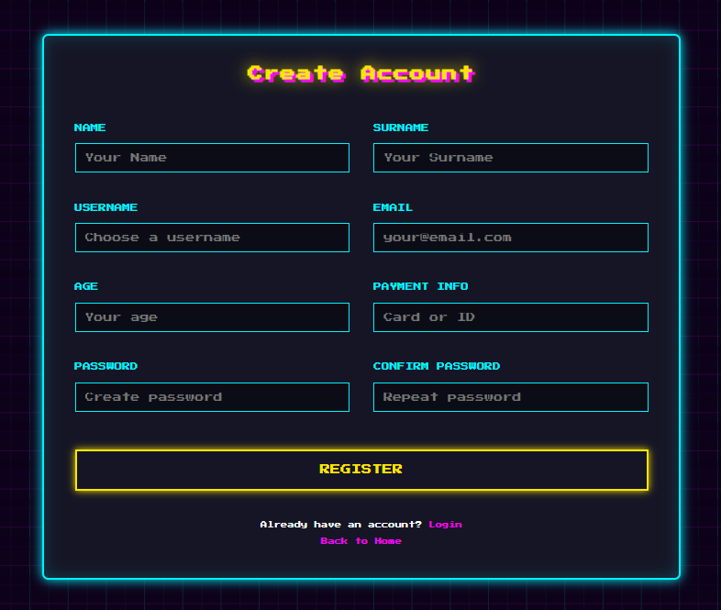
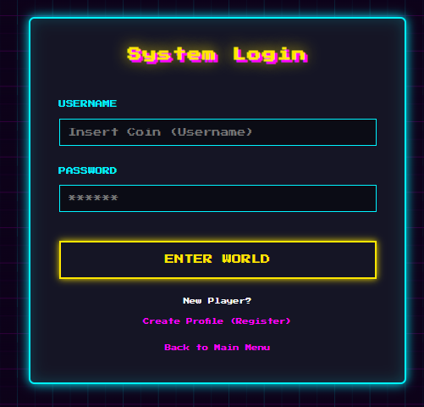
USER MANUAL & MOCKUPS 6
Registration Page
Login page

Slide 18
Master Of Science in Computer Engineering and AIDE
Distributed Systems and Middleweare Technologies
THANK YOU FOR THE ATTENTION
Megan Maremmani
Eleni Zewdu Belayhun
Ettore Di Donato

